Slide 1
Intel
Performed:
Rustam Gummetov
Б04-191-3

Slide 2
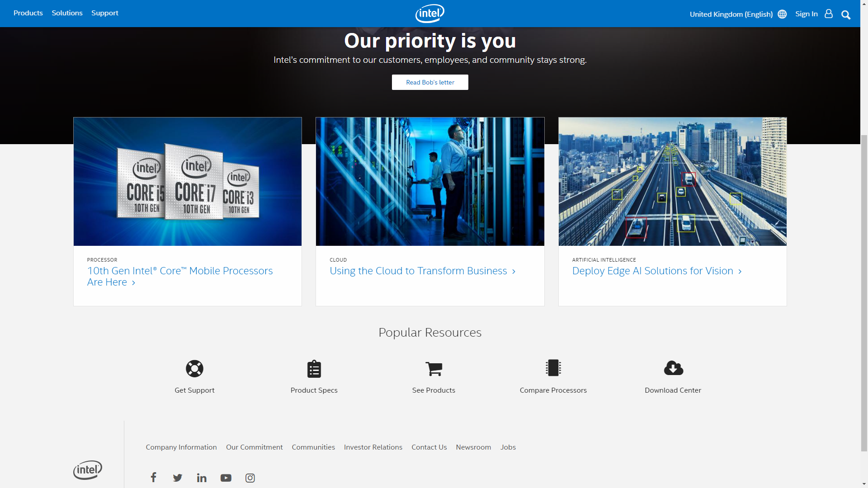
Main page
The main page has a user friendly interface.

Slide 3
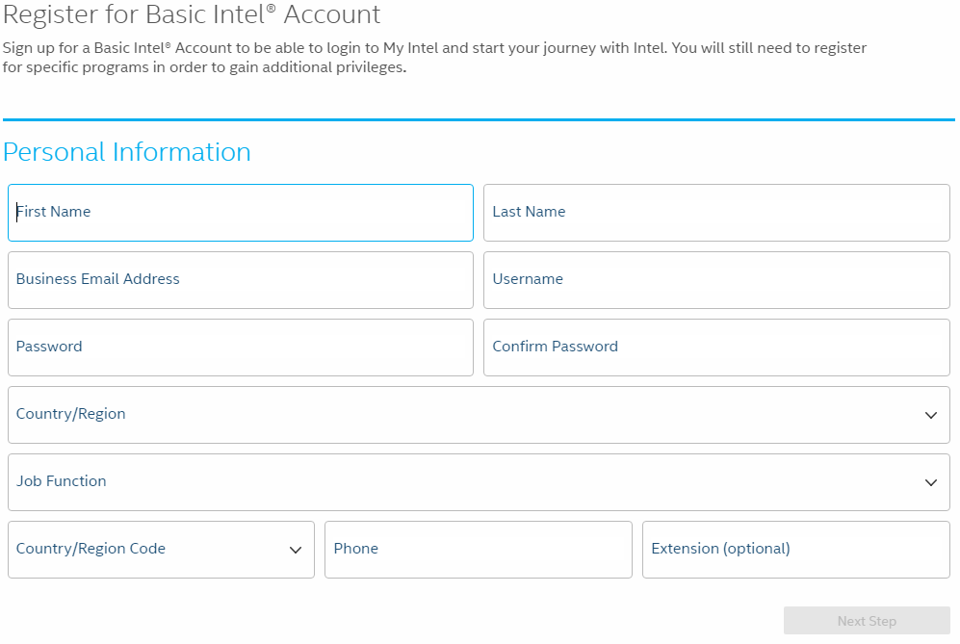
Registration
The Intel site allows the user to create an Intel account. This feature facilitates the process of collecting information about the interests of potential partners and clients.

Slide 4
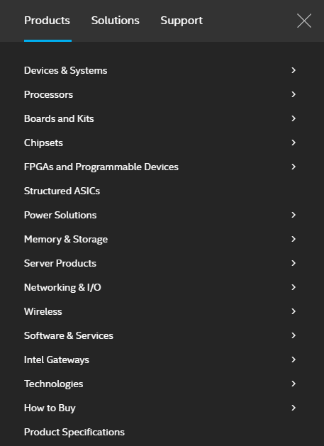
Products
The intel product catalog allows the user to find out what Intel produces and choose the desired product category.

Slide 5
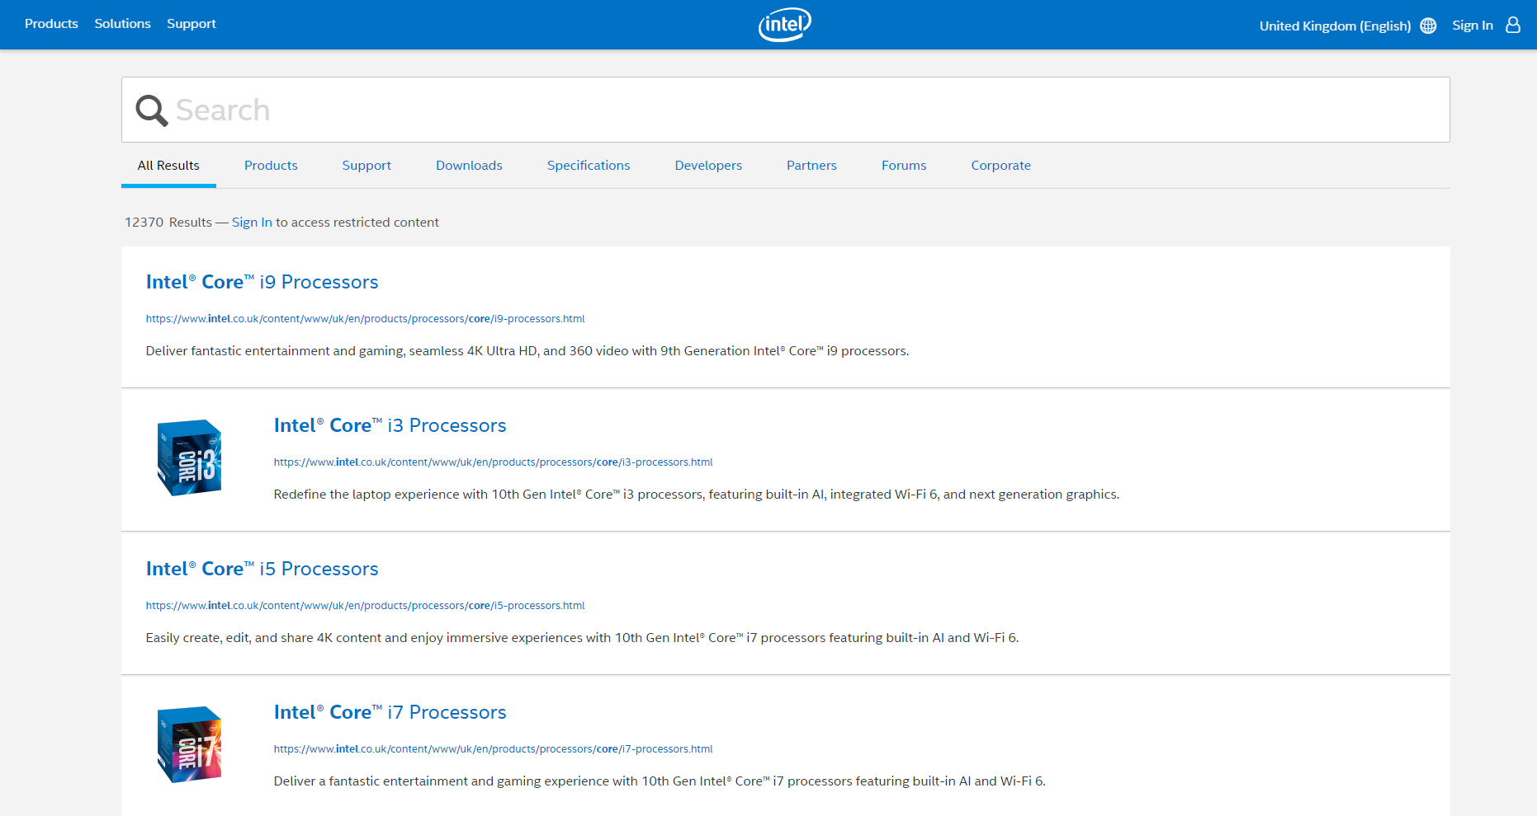
Search
If the user knows exactly what they need, the search allows to find a specific product.

Slide 6
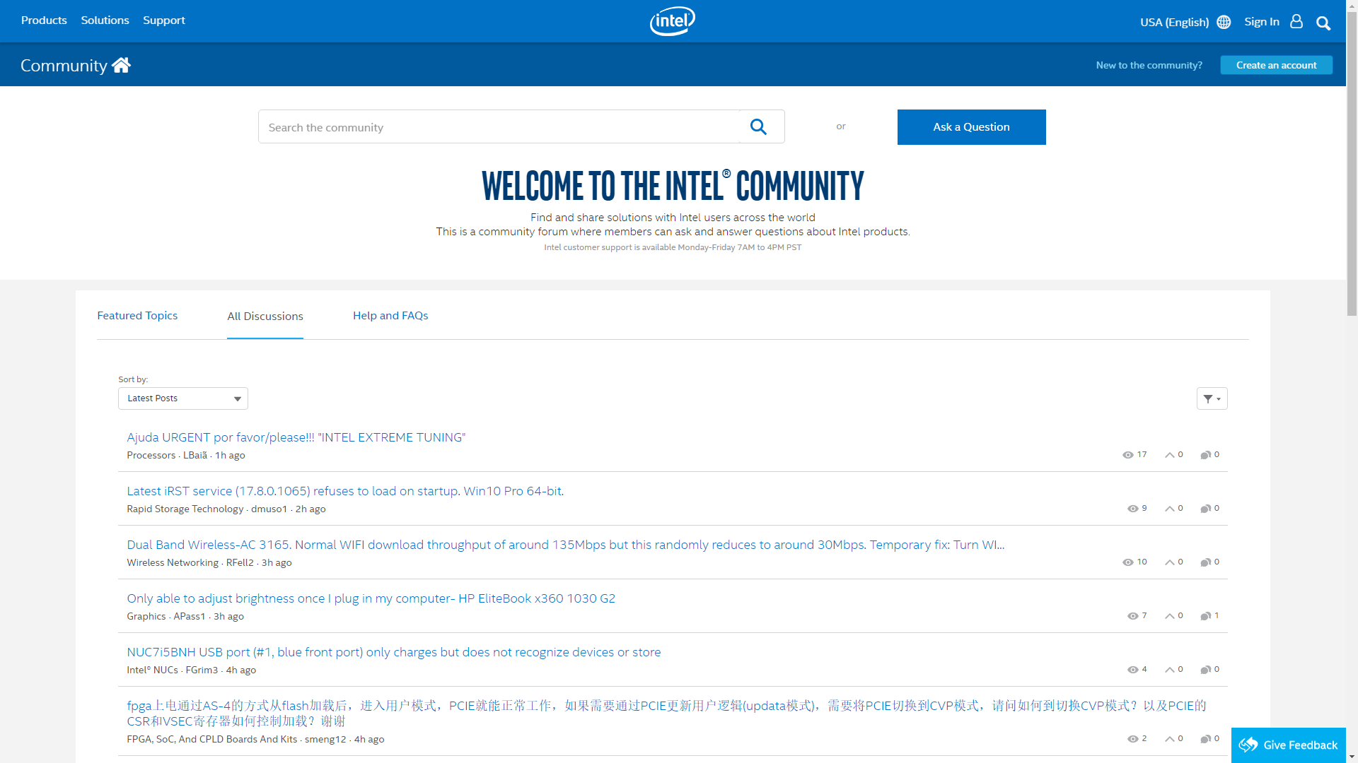
Intel Community
On the Intel website, all users can ask questions and discuss Intel products.

Slide 7
Thanks for attention

